Slide 1
A Lumped-Parameter Modeling, Calibration, and Capacity-Measure Framework for Flux Generation in Symmetric Multipole Electromagnetic Actuators

Slide 2
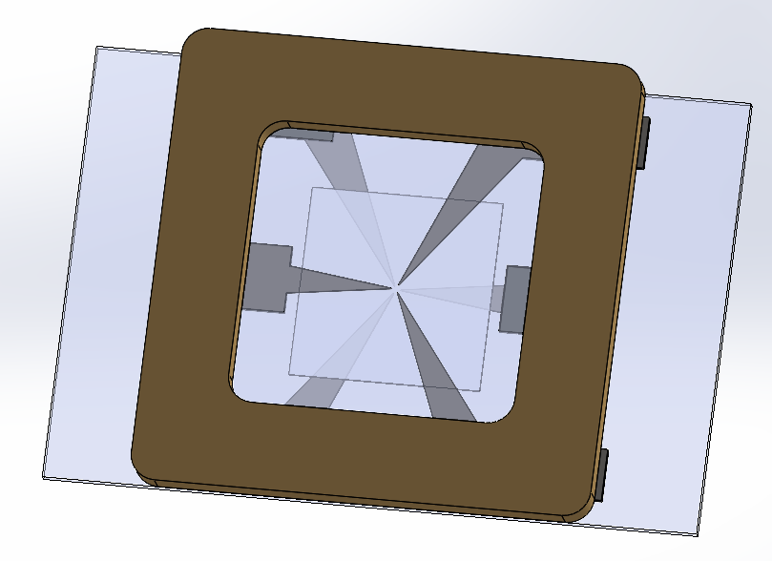
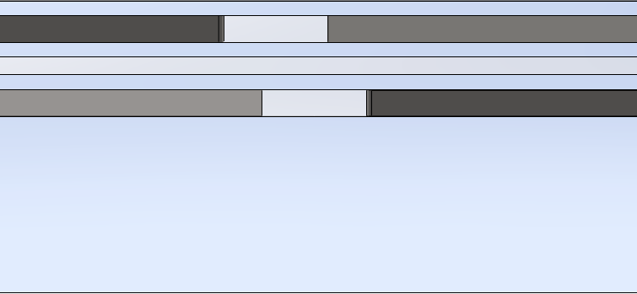
CAD MODEL
The first-row left figure shows the top view of the overall mechanism, while the right figure is a zoomed-in side view of the red-circled region. The bottommost glass slide is 1.2 mm thick, with the lower magnetic poles attached to it. The second and third coverslips are each 0.13 mm thick, with a 120 μm gap between them. The sample is placed on the second coverslip. The topmost coverslip is also 0.13 mm thick, with the upper magnetic poles attached to it. Each magnetic pole is 178 μm thick.
P3
P5
P1
P2
P6
P4
Magnetic pole
Specimen
Coverslips

Slide 3
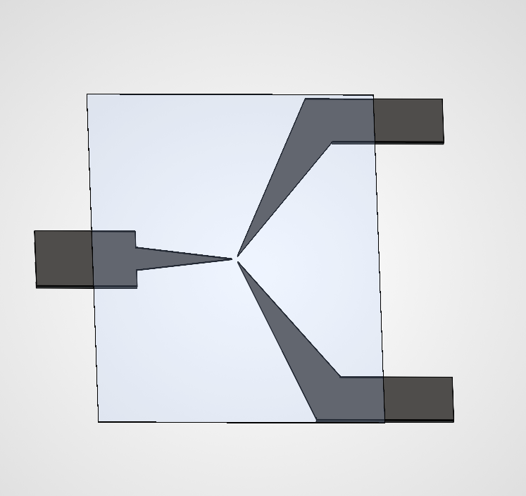
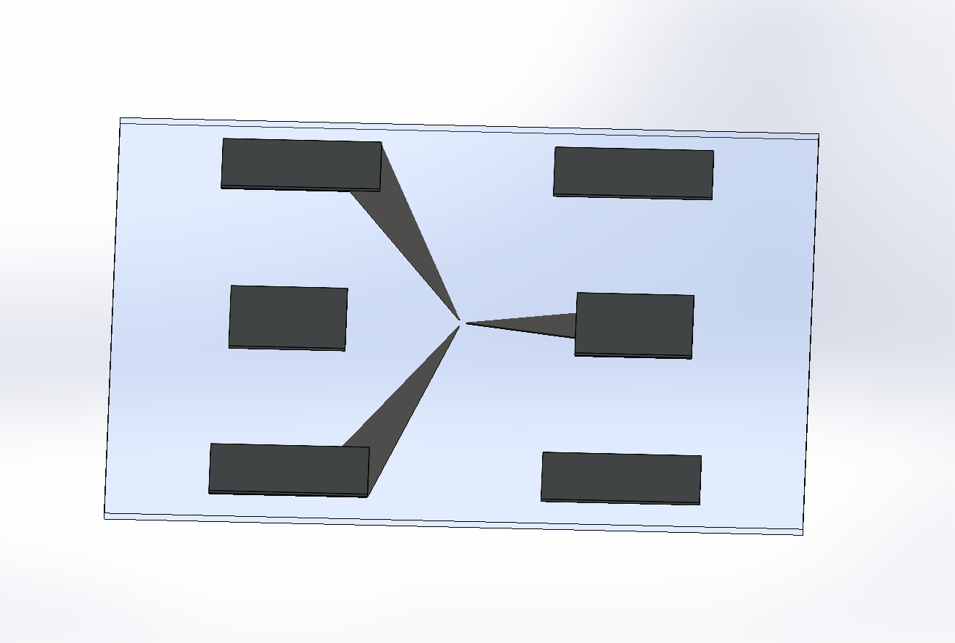
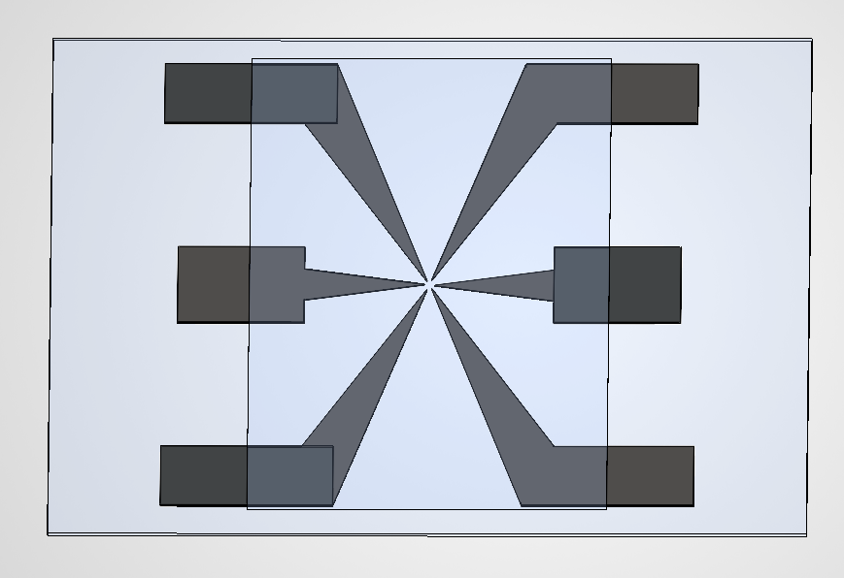
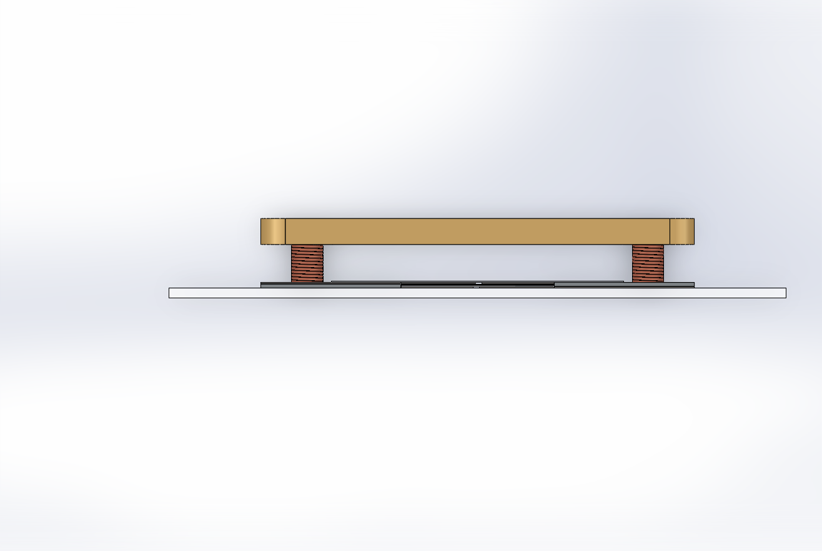
CAD MODEL
The upper-left, upper-right, and lower-left figures show the upper and lower magnetic pole structures, separated by a 508 μm-thick spacer. The lower-right figure shows the side view, where the coil and yoke can be identified.
Spacer
Magnetic poles
Coverslip
Coil
Yoke

